Slide 1
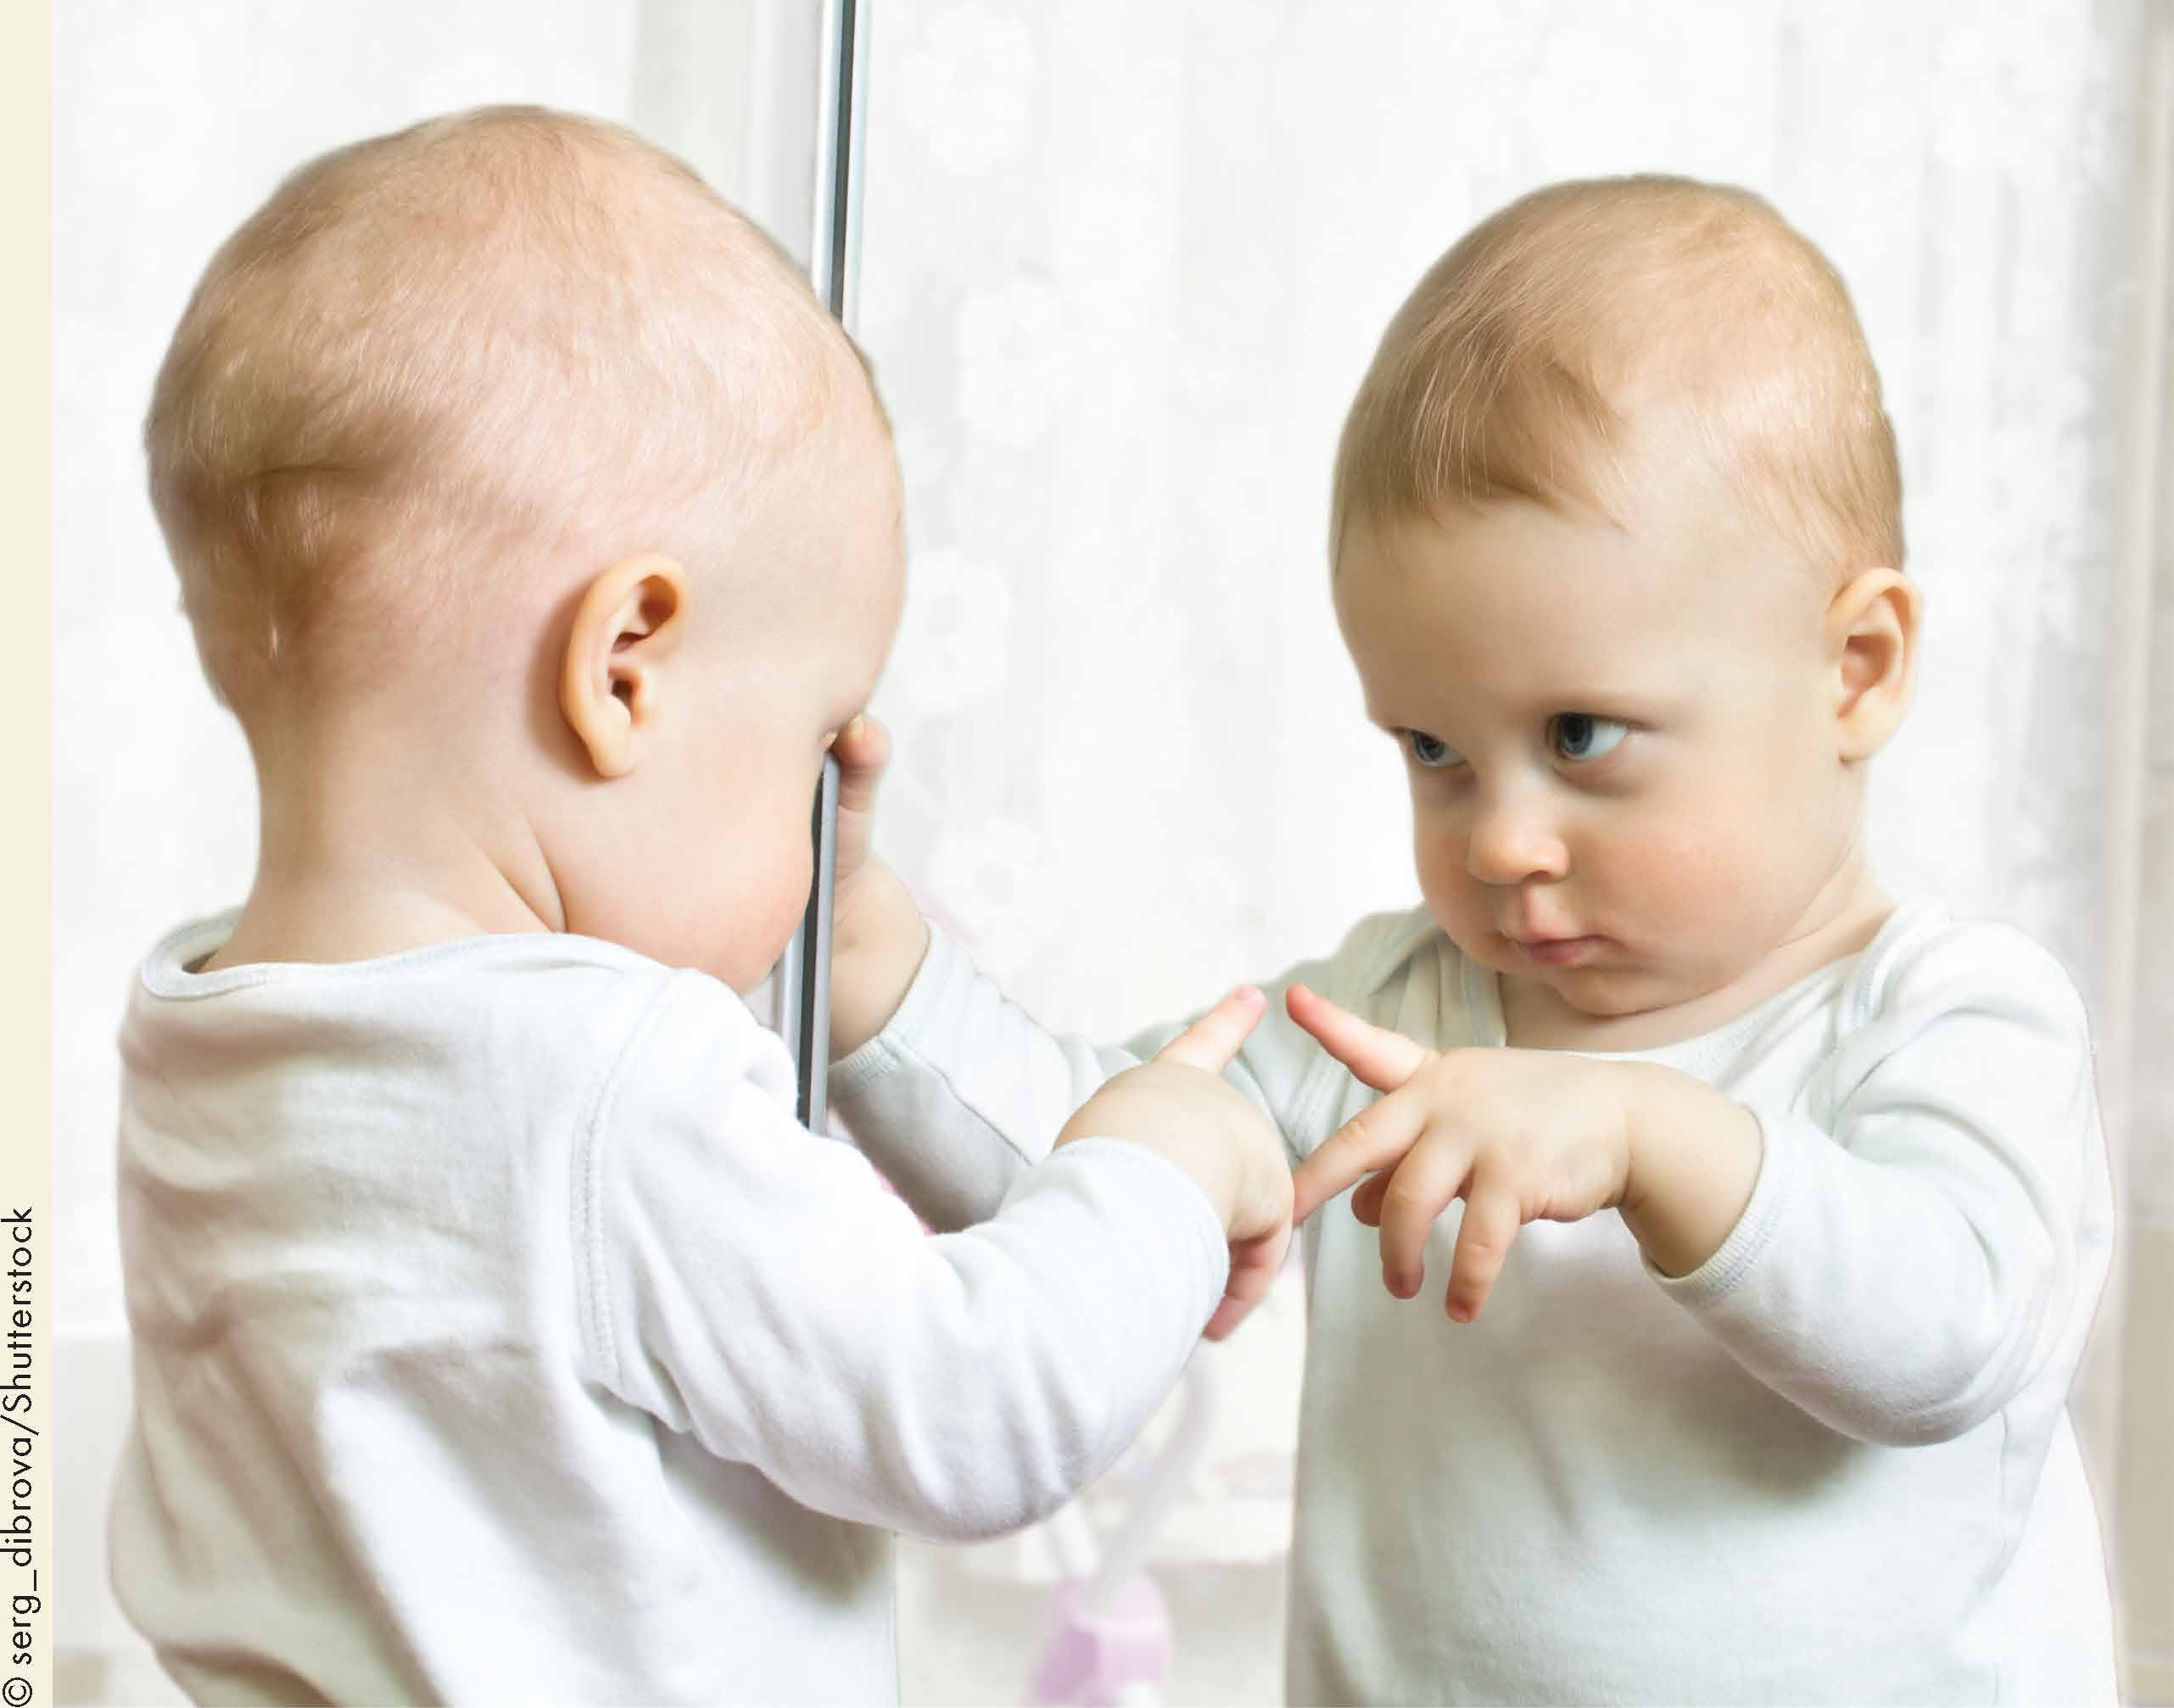
Chapter 2
Communication and the Creation of Self

Slide 2
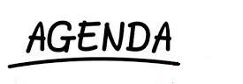
Define “the self”
Attachment Styles
Race & Ethnicity
Gender
The Self is Multidimensional
The Development of the Self
Self-Concept

Slide 3
What Is the Self?
Arises in Communication with Others
Particular Others
Direct Definition
Reflected Appraisal
Looking glass self
Identity Scripts
Schemas
Attachment Styles
Dr. Ainsworth

Slide 4
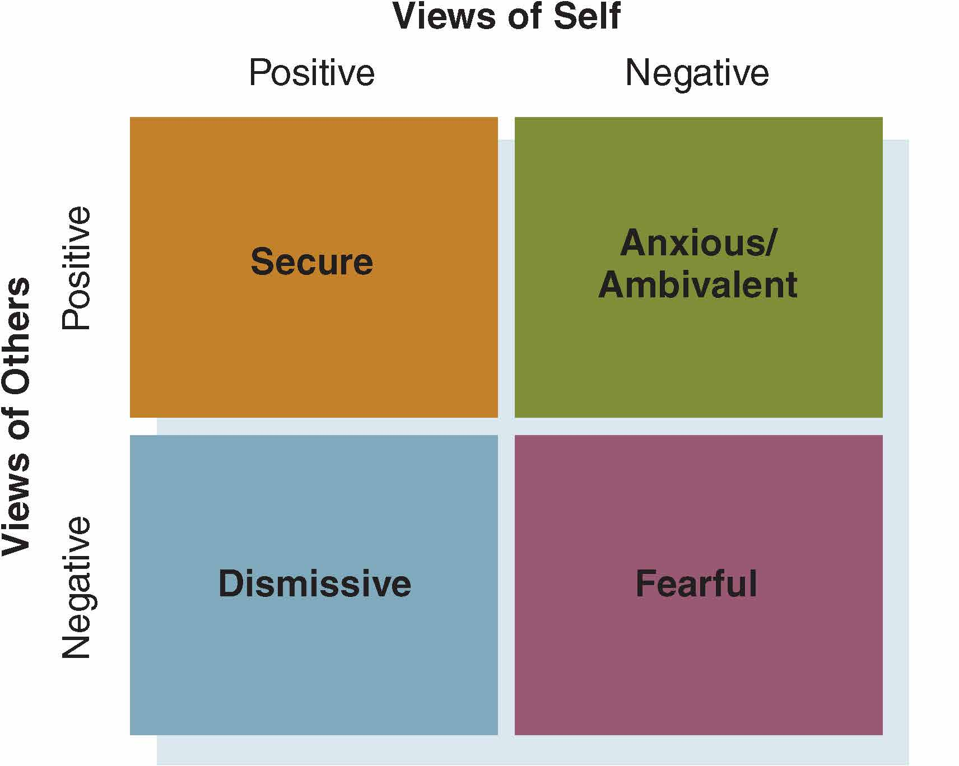
Attachment Styles

Slide 5
Self-Fulfilling Prophecy
Beliefs
(Self-Concept)
Future Behaviour & Decision Making
Self-fulfilling Prophecy
Debilitating
Feelings
Behaviour

Slide 6
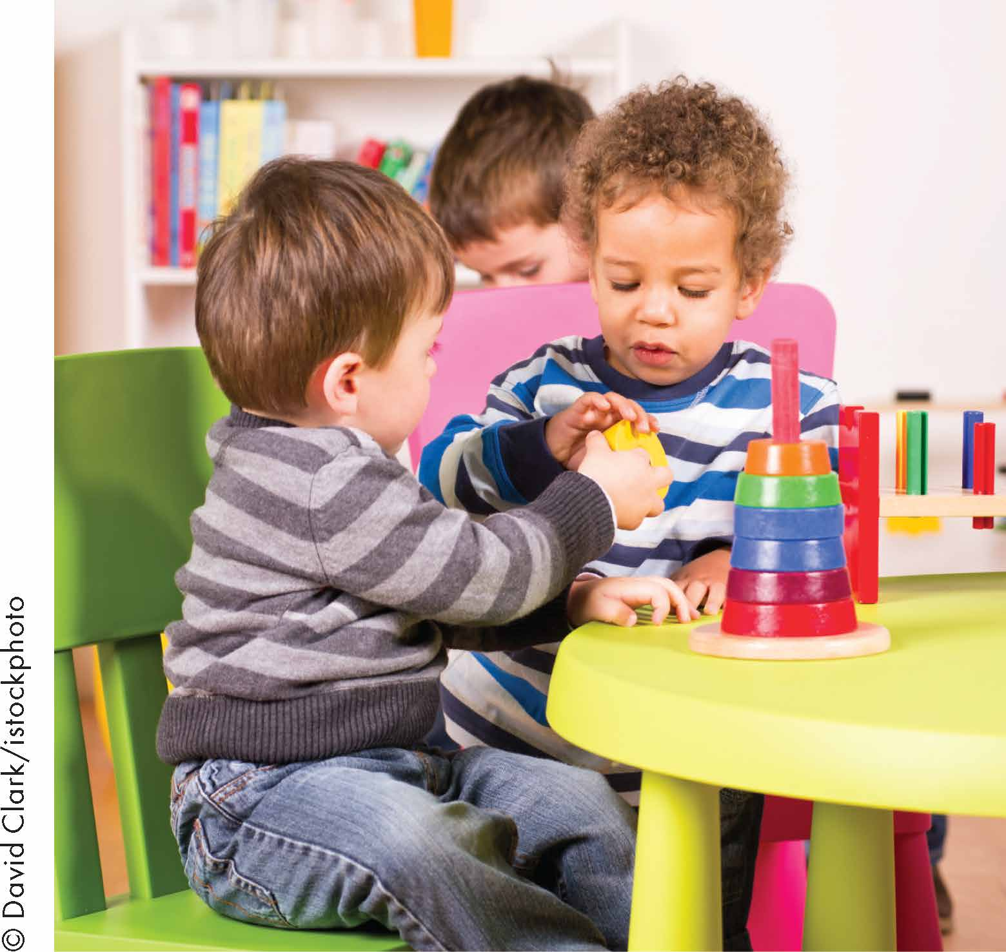
The Generalized Other
Race and Ethnicity
Gender
Sexual Orientation
Socioeconomic Status
Social Comparison

Slide 7
Race & Ethnicity
Considered the primary aspects of personal identity
Race has focused on skin colour – red, white, black, or yellow
Ethnicity has focused on an affiliation to a group, nationality, or culture

Slide 8
Gender
Past
Men – rational, competent, entitled, and privileged
Women were not permitted to:
Own property
Gain professional training
Vote
“rule of thumb”
Women are “persons” – October 18, 1929

Slide 9
Sexual Orientation
Past
Heterosexuality viewed as normal
Gays, lesbians, bisexuals viewed as abnormal
Denied social and legal recognition

Slide 10
Socioeconomic Status
Income
Job
Status
Social circles
Economic security
Class

Slide 11
Stereotypes of the Generalized Other
Self-Concept
Socioeconomic Status
Race and Ethnicity
Sexual Orientation
Gender

Slide 12
Social Comparison
Upward Social Comparison
Downward Social Comparison
Extreme vs. Realistic Comparisons

Slide 13
The Self is Multidimensional
Social
Cognitive
Moral
Physical

Slide 14
Social
Constructed Social Views
Constructed in particular cultures at specific times
Differing Social Views
Arbitrary in nature and vary from culture to culture
Changing Social Views

Slide 15
Guidelines for Improving Self-Concept
Make a Firm Commitment to Personal Growth
Gain and Use Knowledge to Support Personal Growth
Set Goals That Are Realistic and Fair
Seek Contexts That Support Personal Growth

Slide 16
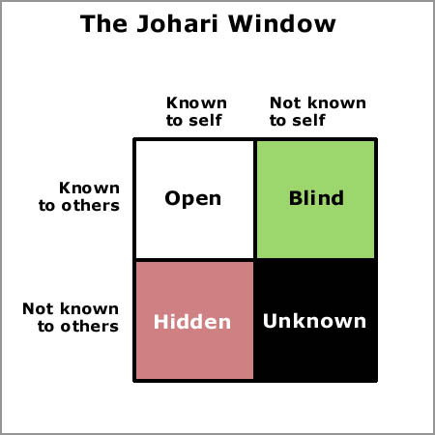
Personal Growth
Self-disclosure
Relevant, appropriate, reciprocal
Johari Window

Slide 17
Summary
The Self
Attachment Style
Dimensions of the Self
Chapter 2
Self- Concept
Social Comparison
Personal Growth & Change
Self-Disclosure

